Slide 1
using Python and Open Street Maps
With Pandas, NumPy and MatplotLib

Slide 2
I dag skal vi arbejde følgende
The goal
Setup & Data
Methods
Conclusion

Slide 3
Indledning
Visualization of the GPS data can be challenging when using programming languages. Some interesting Python packages can be used for such purposes. But, it can be hard to install and use them in some cases, especially if you have only a simple task to do. This article will show the simple but effective GPS records visualization method using Python and Open Street Maps (OSM). If you want to skip straight to the code, visit https://github.com/tisljaricleo/GPS-visualization-Python.

Slide 4
The goal
The image below shows the goal of this method. There are three main elements that need to be included:
Map image — map in some image format like .png, .jpg, etc.
GPS records — records that consist of (latitude, longitude) pairs.
Geographical coordinates — conversion from pixels to geographical coordinates.

Slide 5
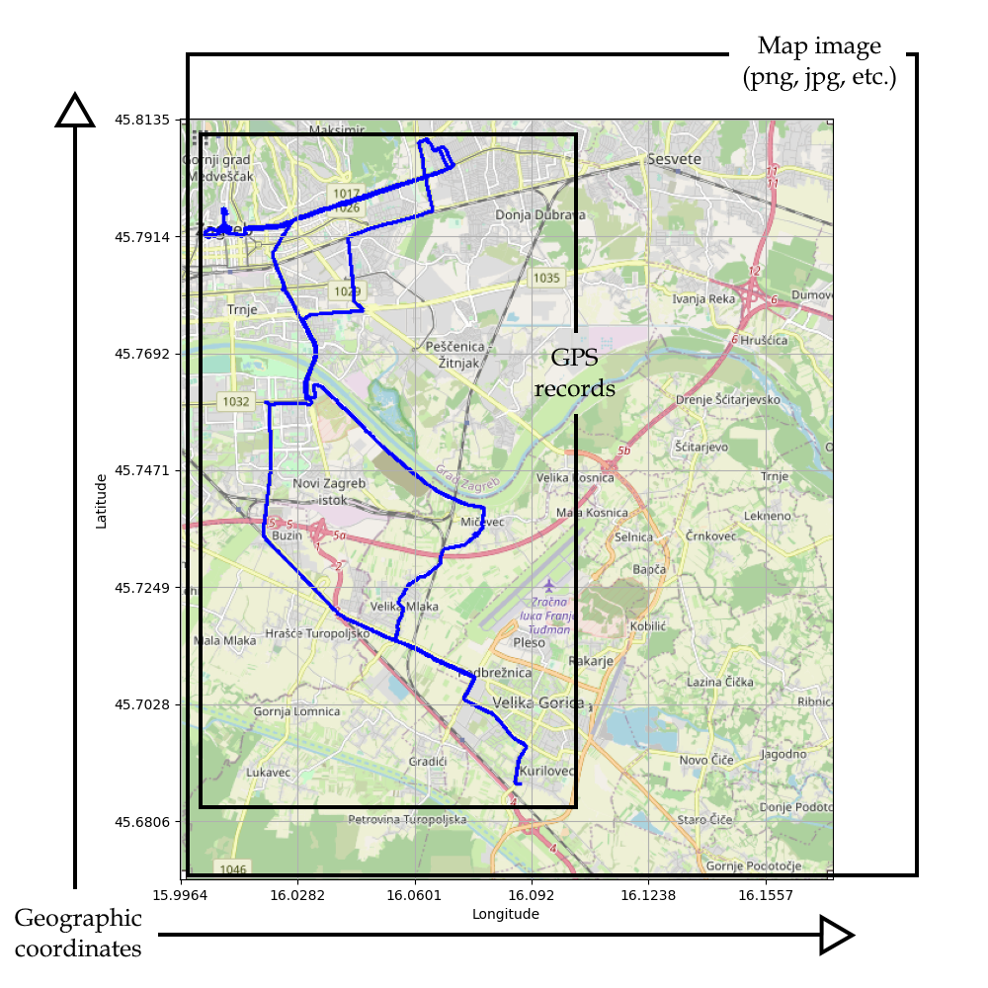
The MAP

Slide 6
Setup & Data
The easiest way to use code below is to install VS Code or some other IDE for editing Python code. Python Jupyter notebook users could encounter some problems or additional setup. The easiest way is to run main.py script directly from one of the IDEs.
For this article, a small GPS dataset is used collected with the Columbus V-990 logger that I’ve carried in my pocket for two days. Data is available at the github repository.
It is a simple (latitude, longitude) dataset with around 35000 records and looks like this:

Slide 7
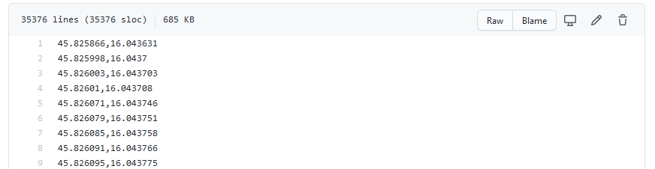
GPS-coordinates
Important note: To successfully run a code, data must be formatted in exact way as shown in the image above. Otherwise, the code will result in error!

Slide 8
Methods
Here, we will go through all the steps needed for this method to work. For the full code, visit the github repository.
1. Get the map
The map can be downloaded from https://www.openstreetmap.org/export. Just choose the part of the map that you need by clicking “Manually select a different area.” Write down the coordinates of the upper left, and lower right corners in this case (45.8357, 15.9645) and (45.6806, 16.1557)

Slide 9
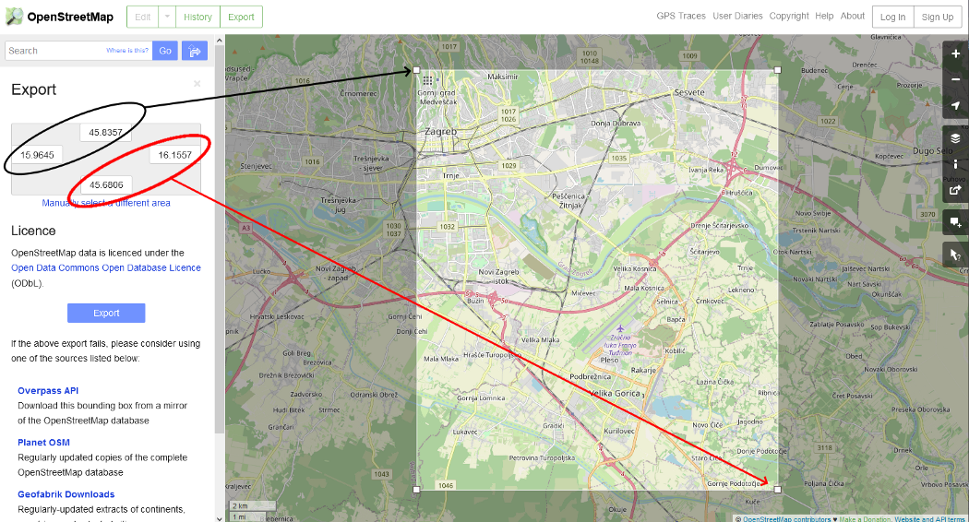
A practical example of the MAP method
Then export it by using the “Share” button on the right side. Don’t forget to choose the option “Set custom dimensions” and align the view to the selected area.

Slide 10
Python code Importing packages and data:
import pandas as pd
import numpy as np
import matplotlib.pyplot as plt
from PIL import Image, ImageDraw
data_path = 'data.csv'
data = pd.read_csv(data_path, names=['LATITUDE', 'LONGITUDE'], sep=',')

Slide 11
To draw geographic coordinates on the image, coordinates must be converted to image pixels. Method scale_to_img(gps_coordinate, (image_height, image_width)) takes the GPS coordinates and converts it to image coordinates (pixels) based on the image width and height.
gps_data = tuple(zip(data['LATITUDE'].values, data['LONGITUDE'].values))
image = Image.open('map.png', 'r') # Load map image.
img_points = []
for d in gps_data:
x1, y1 = scale_to_img(d, (image.size[0], image.size[1])) # Convert GPS coordinates to image coordinates.
img_points.append((x1, y1))
draw = ImageDraw.Draw(image)
draw.line(img_points, fill=(255, 0, 0), width=2) # Draw converted records to the map image.
image.save('resultMap.png')

